Slide 1

President’s report
Avery Denny

Slide 2
Y1’1t’44h Shehataa[ii
Greetings! Hello! Y1’1t’44h Shidin4’4, Shik’47, Shit4’4zh7, Shid4’4y0n7.

Slide 3
First Nations Community Healthsource
Donation of 50 bags of non-perishable food and PPE (face masks and hand sanitizers) for hataałii
We give a shout out to Lorenzo Jim and his crew, staff, and team, etc...
The donation was picked up in Albuquerque, NM.
Distributions were carried out over the past few weeks.

Slide 4
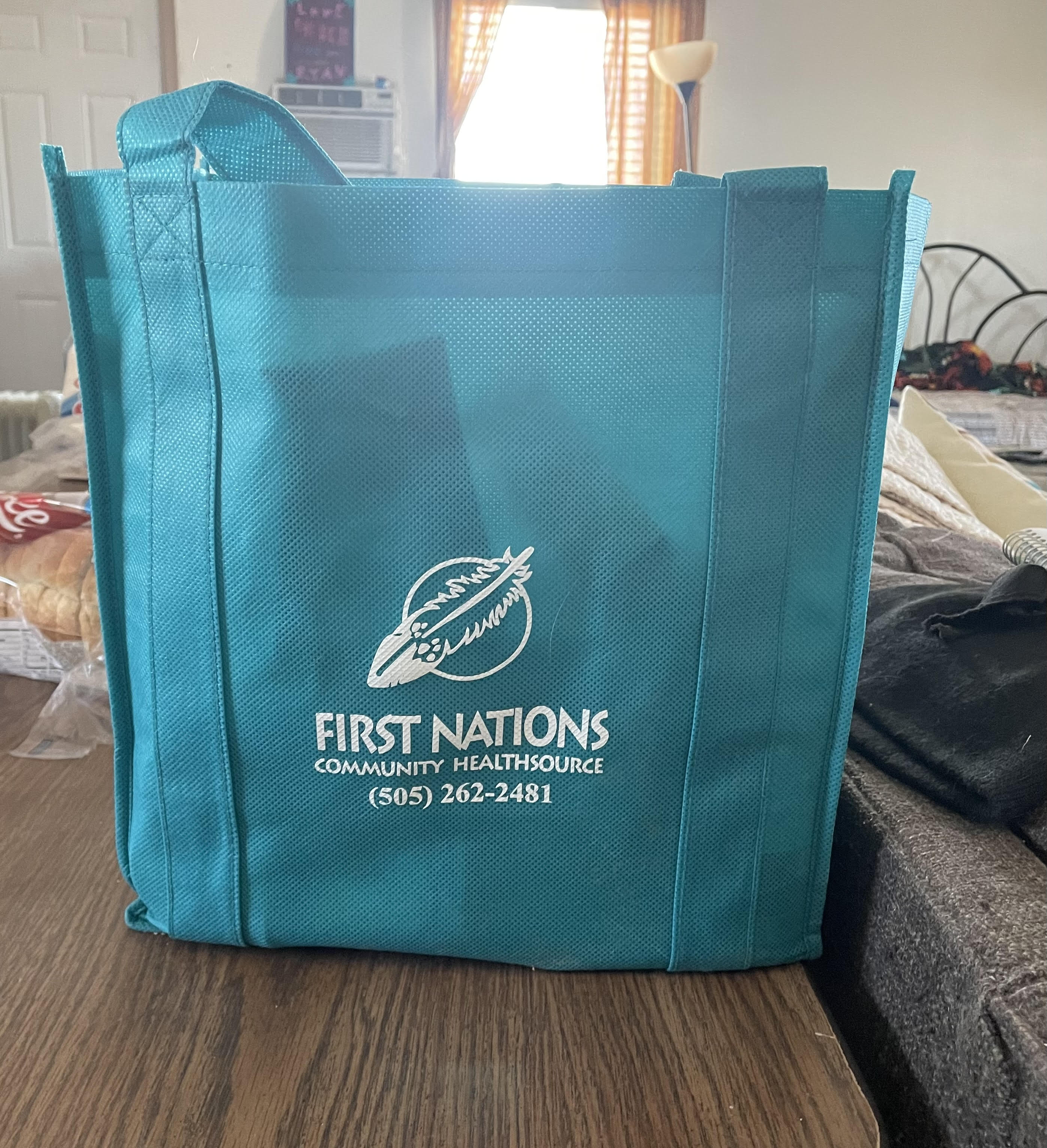
Donation Delivery
A list of 55 was created
42 hataałii received the bags so far
Donations were delivered to their homes
Elders were thankful
Names and contact numbers were collected
Majority of hataałii are over 65 years old
The eldest on record is 87 years old

Slide 5
Concerns expressed by Hataałii
Concerns expressed by hataałii who received the donation:
Ceremonial preservation
Preservation of songs and prayers. Keep it original.
Respect for hataałii and their ceremonies
Ceremonial genes
Don’t show too much, keep it sacred, keep it secret, keep it safe.

Slide 6
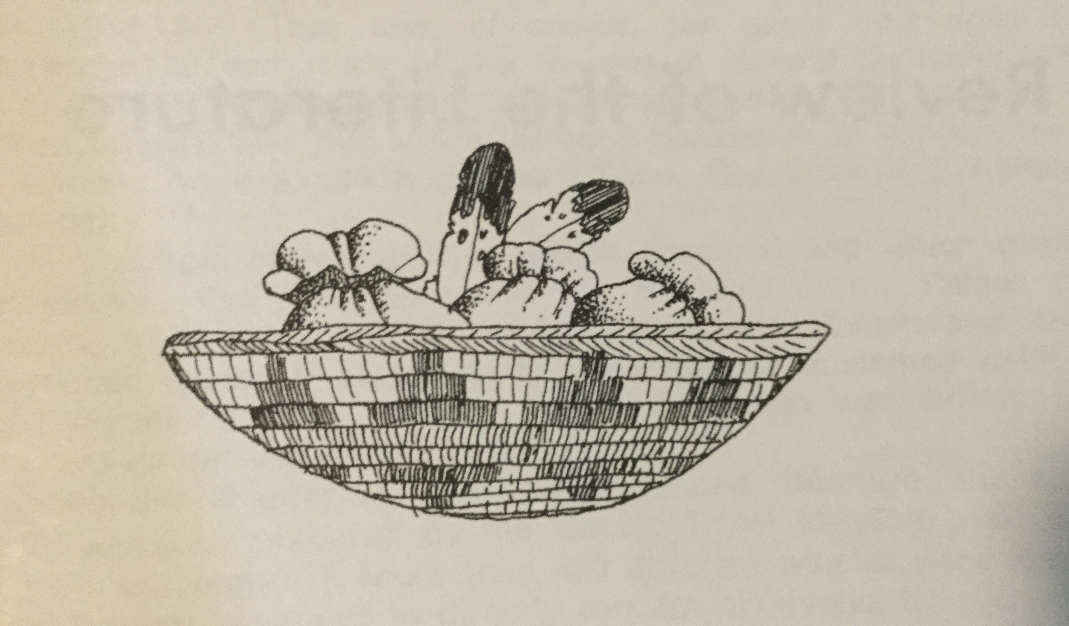
Ahxé’héé

